Slide 1
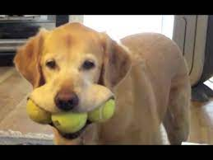
FUN DAY
THE LABRADOR CLUB
Come along and join us with some fun
Blind mans bluff
Obstacle course
Hi vis relay
Water retrieve
Puppy socialisation opportunities
WHEN: SUNDAY 1st May 2022
REGISTRATION AT: 10.00 am
WHERE: NZKC Grounds
743 PAPAKURA ARDMORE ROAD
Please note that this opportunity is open to all members and participating Labradors….
Entry fee $5.00 / family
Bring your Labrador(s) and other family wannabe Labradors– all ages/abilities welcome – puppies should be fully vaccinated
A lead, a water bowl, poop bags
Cash for the BBQ/drinks/raffle
Bring your children / grandchildren – lots of prizes for the younger ones
Enquires Mary Waugh Secretary mwaugh1@gmail.com

